Slide 1



AdentureWorks
View in Power BI
Last data refresh:
12/31/2021 5:30:06 PM UTC
Downloaded at:
3/2/2023 4:39:55 PM UTC

Slide 2
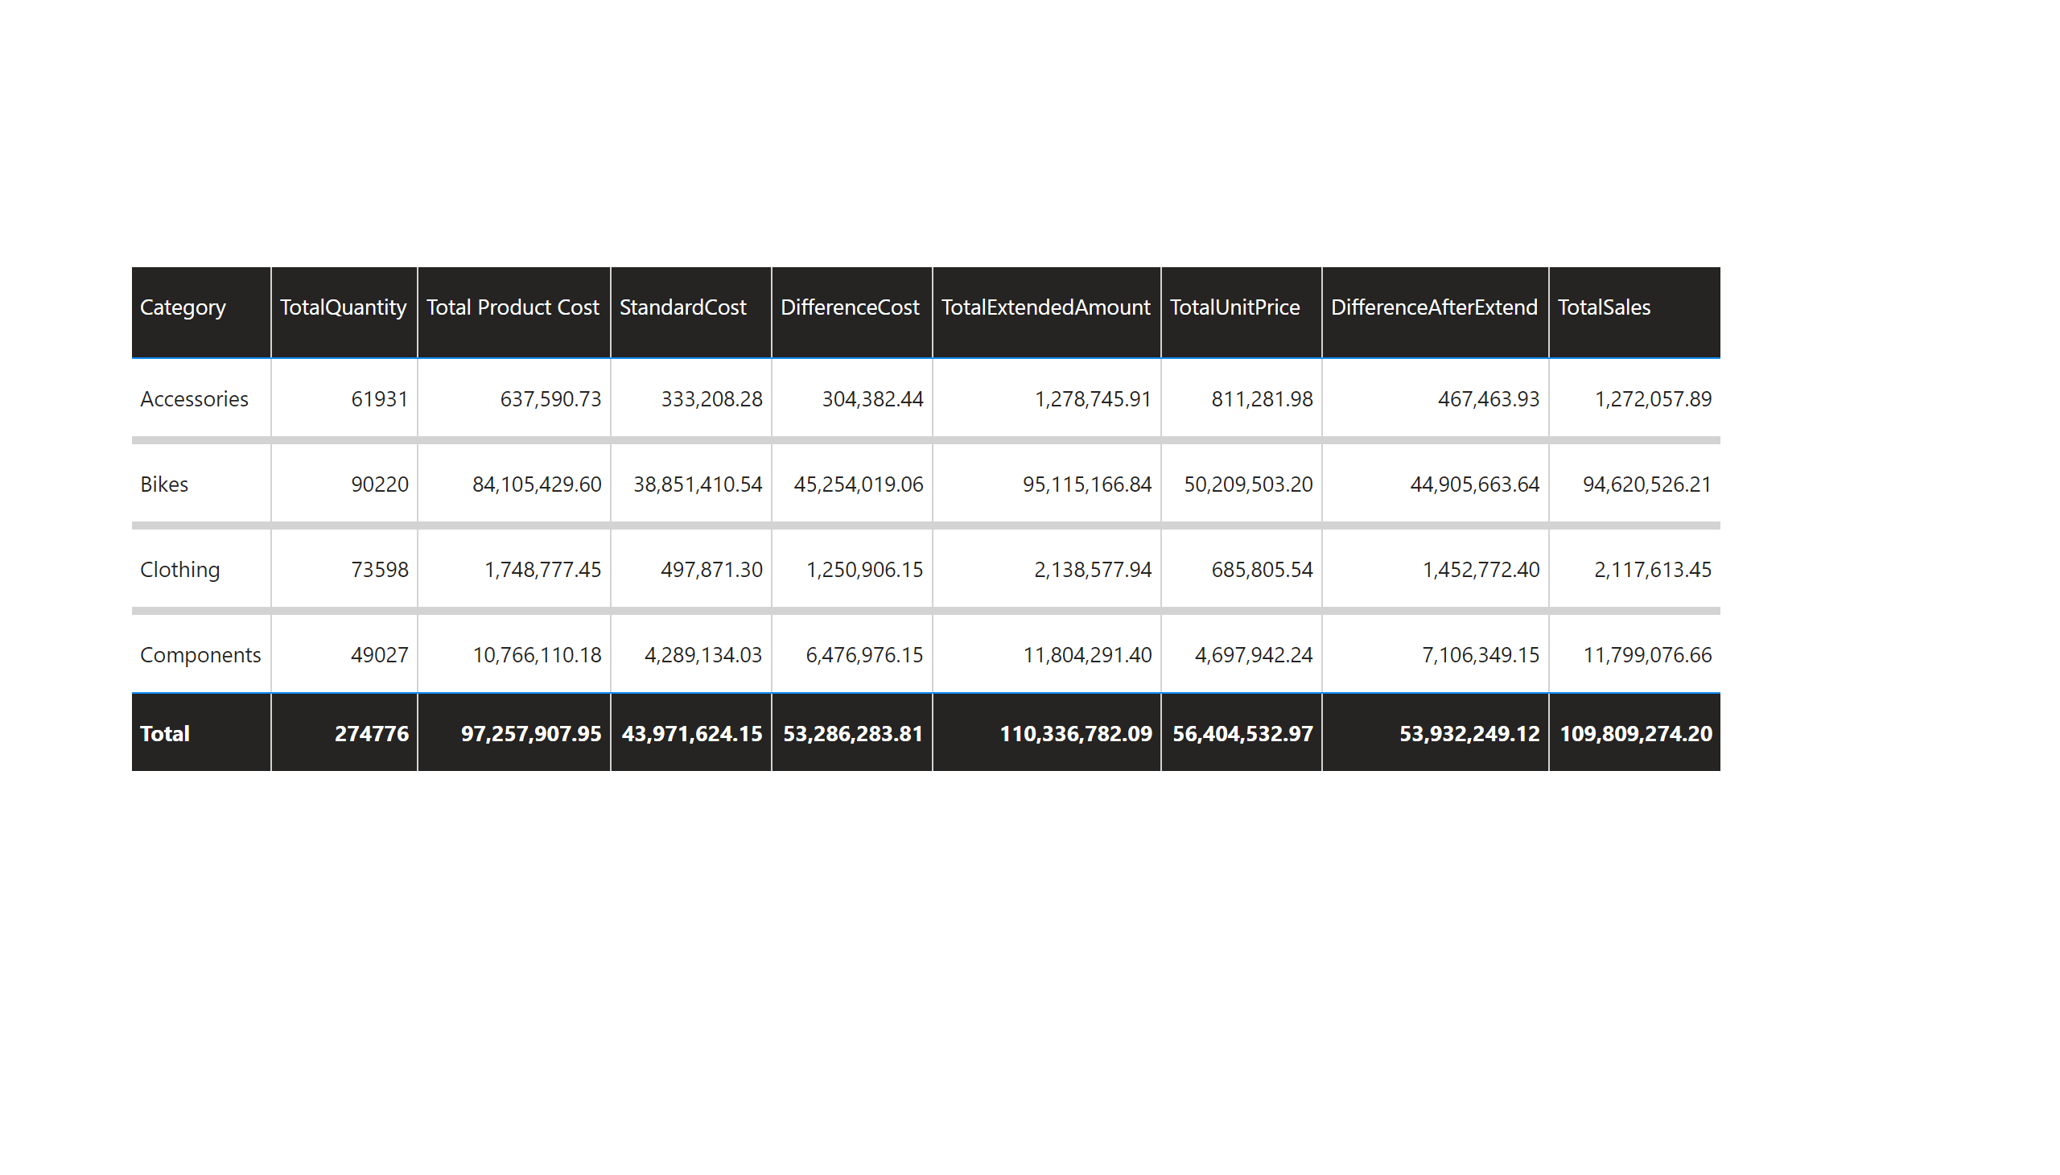
Summary1
Notes:
tableEx
No alt text provided

Slide 3
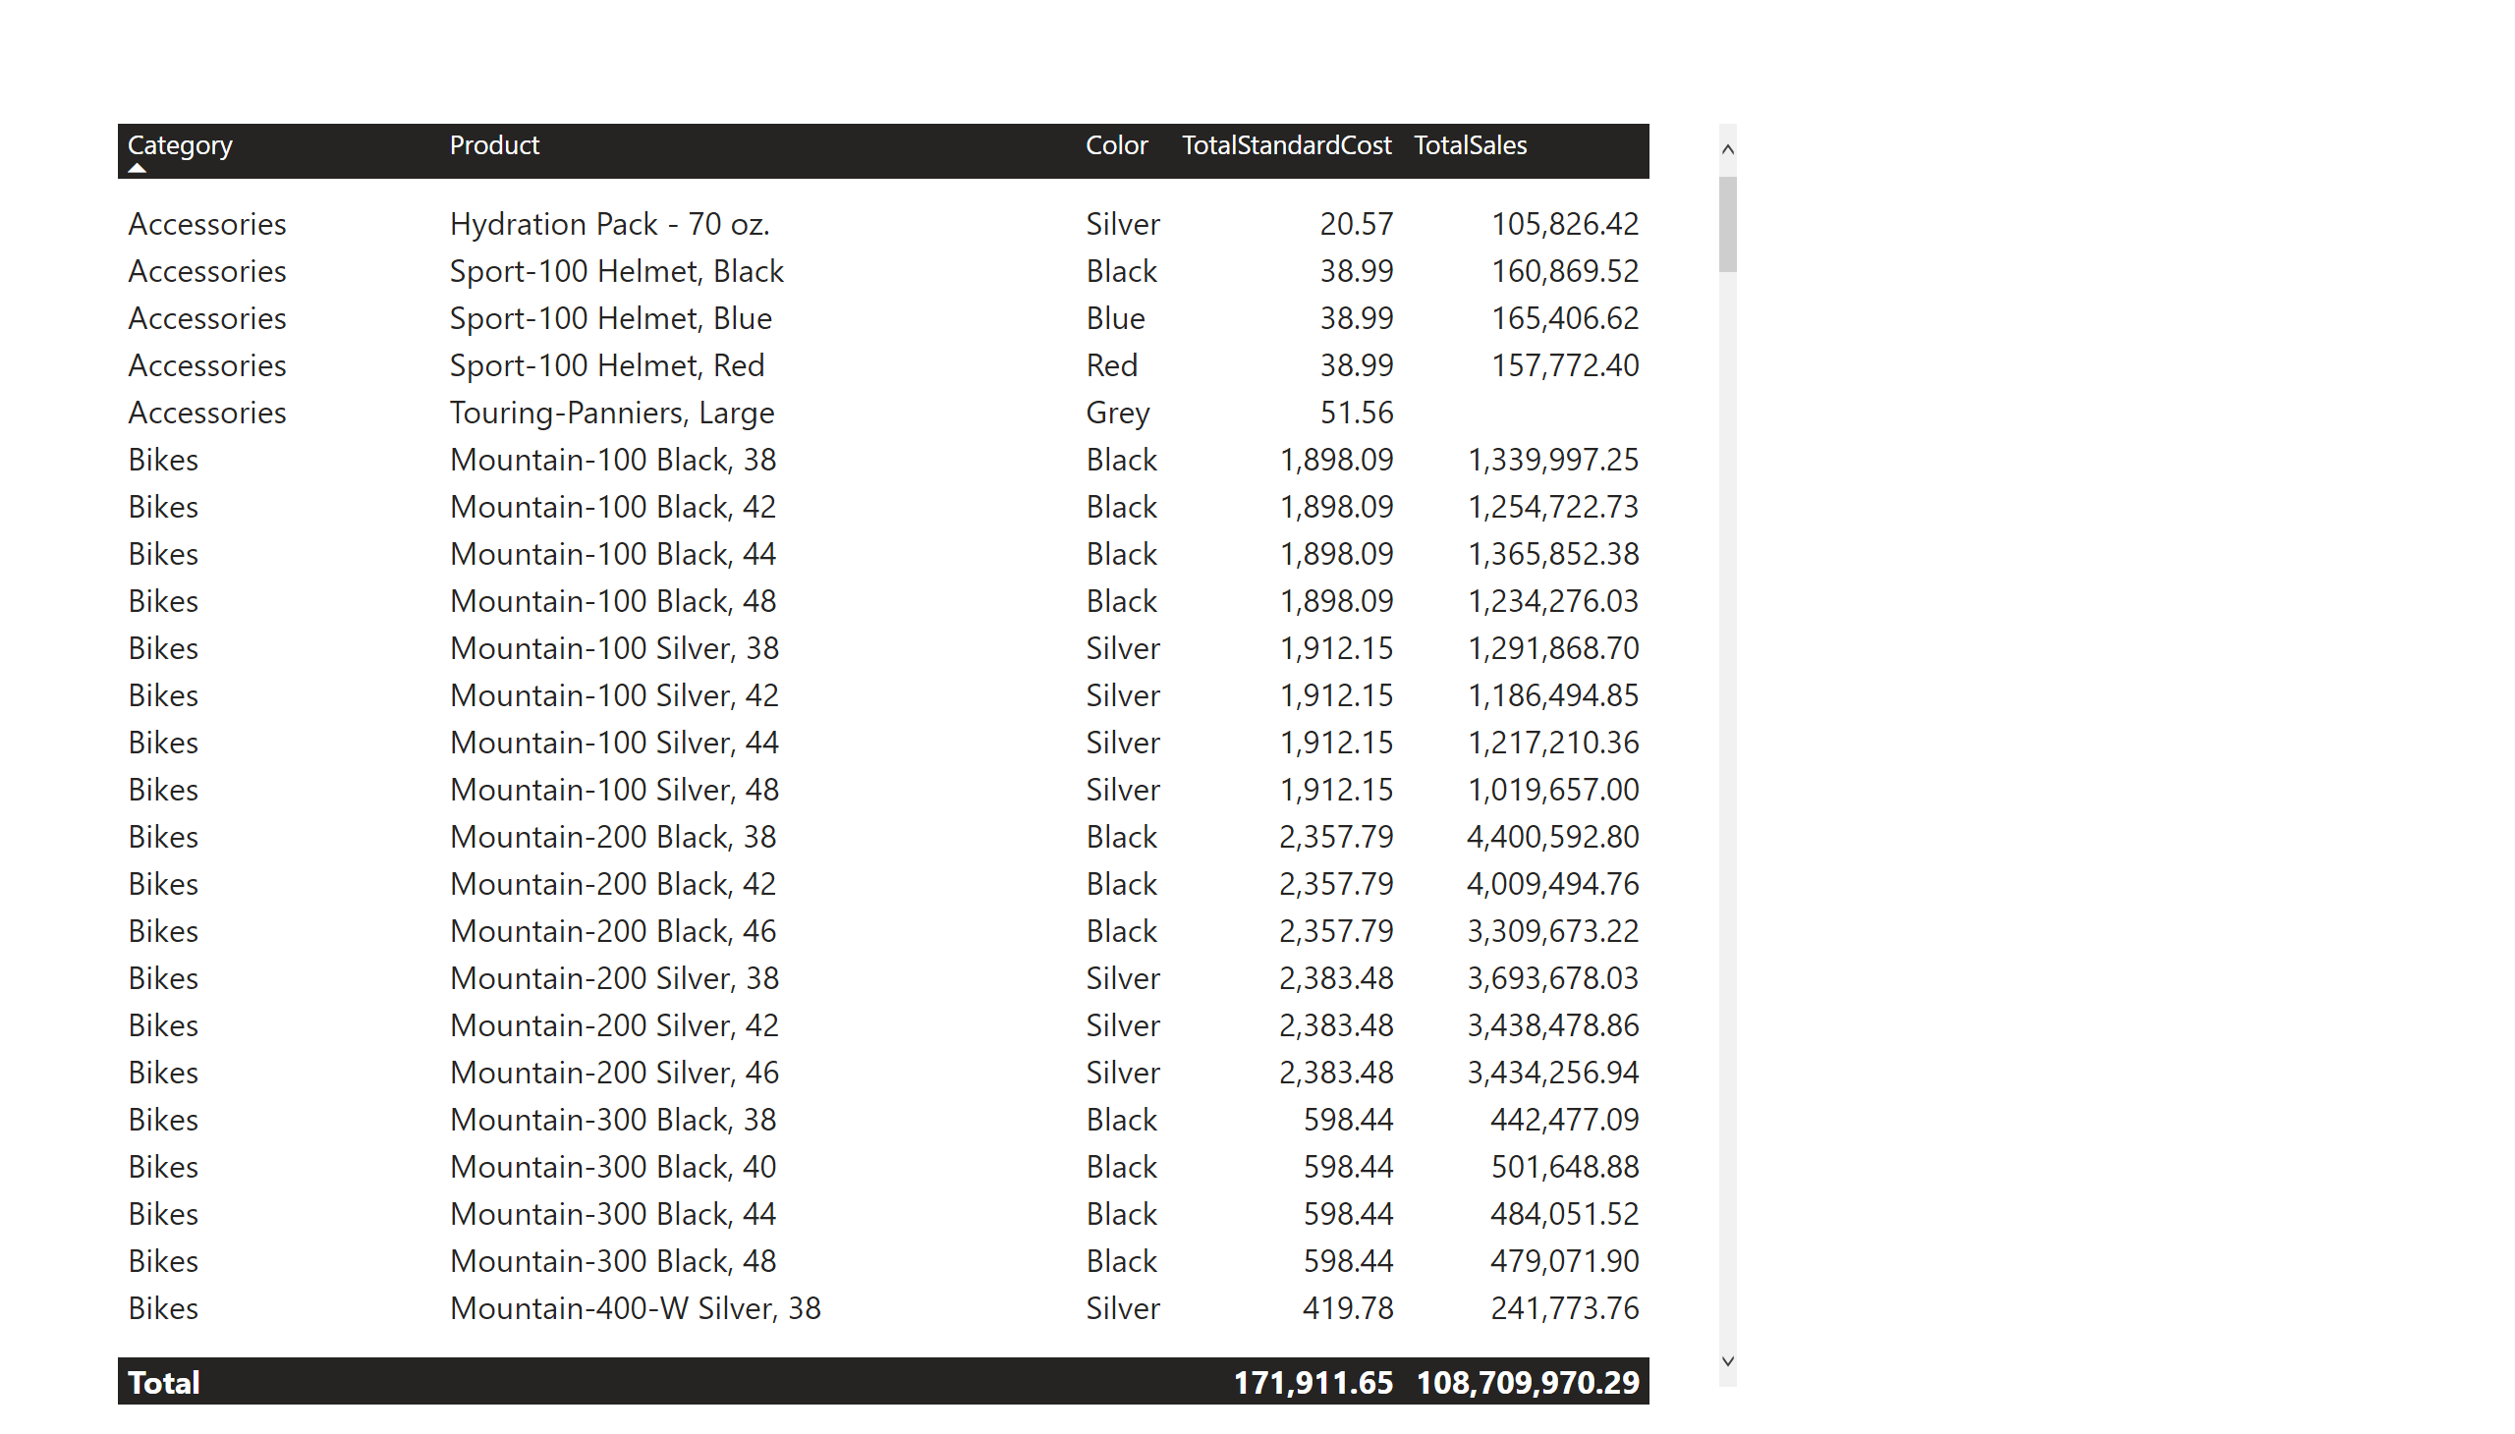
Summary2
Notes:
tableEx
No alt text provided

Slide 4
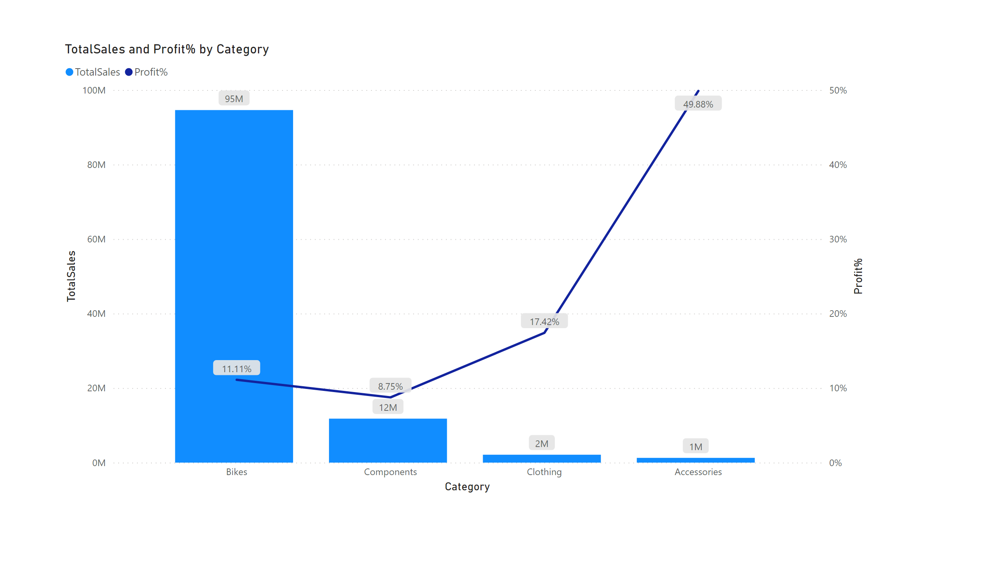
Category
Notes:
lineStackedColumnComboChart
No alt text provided

Slide 5
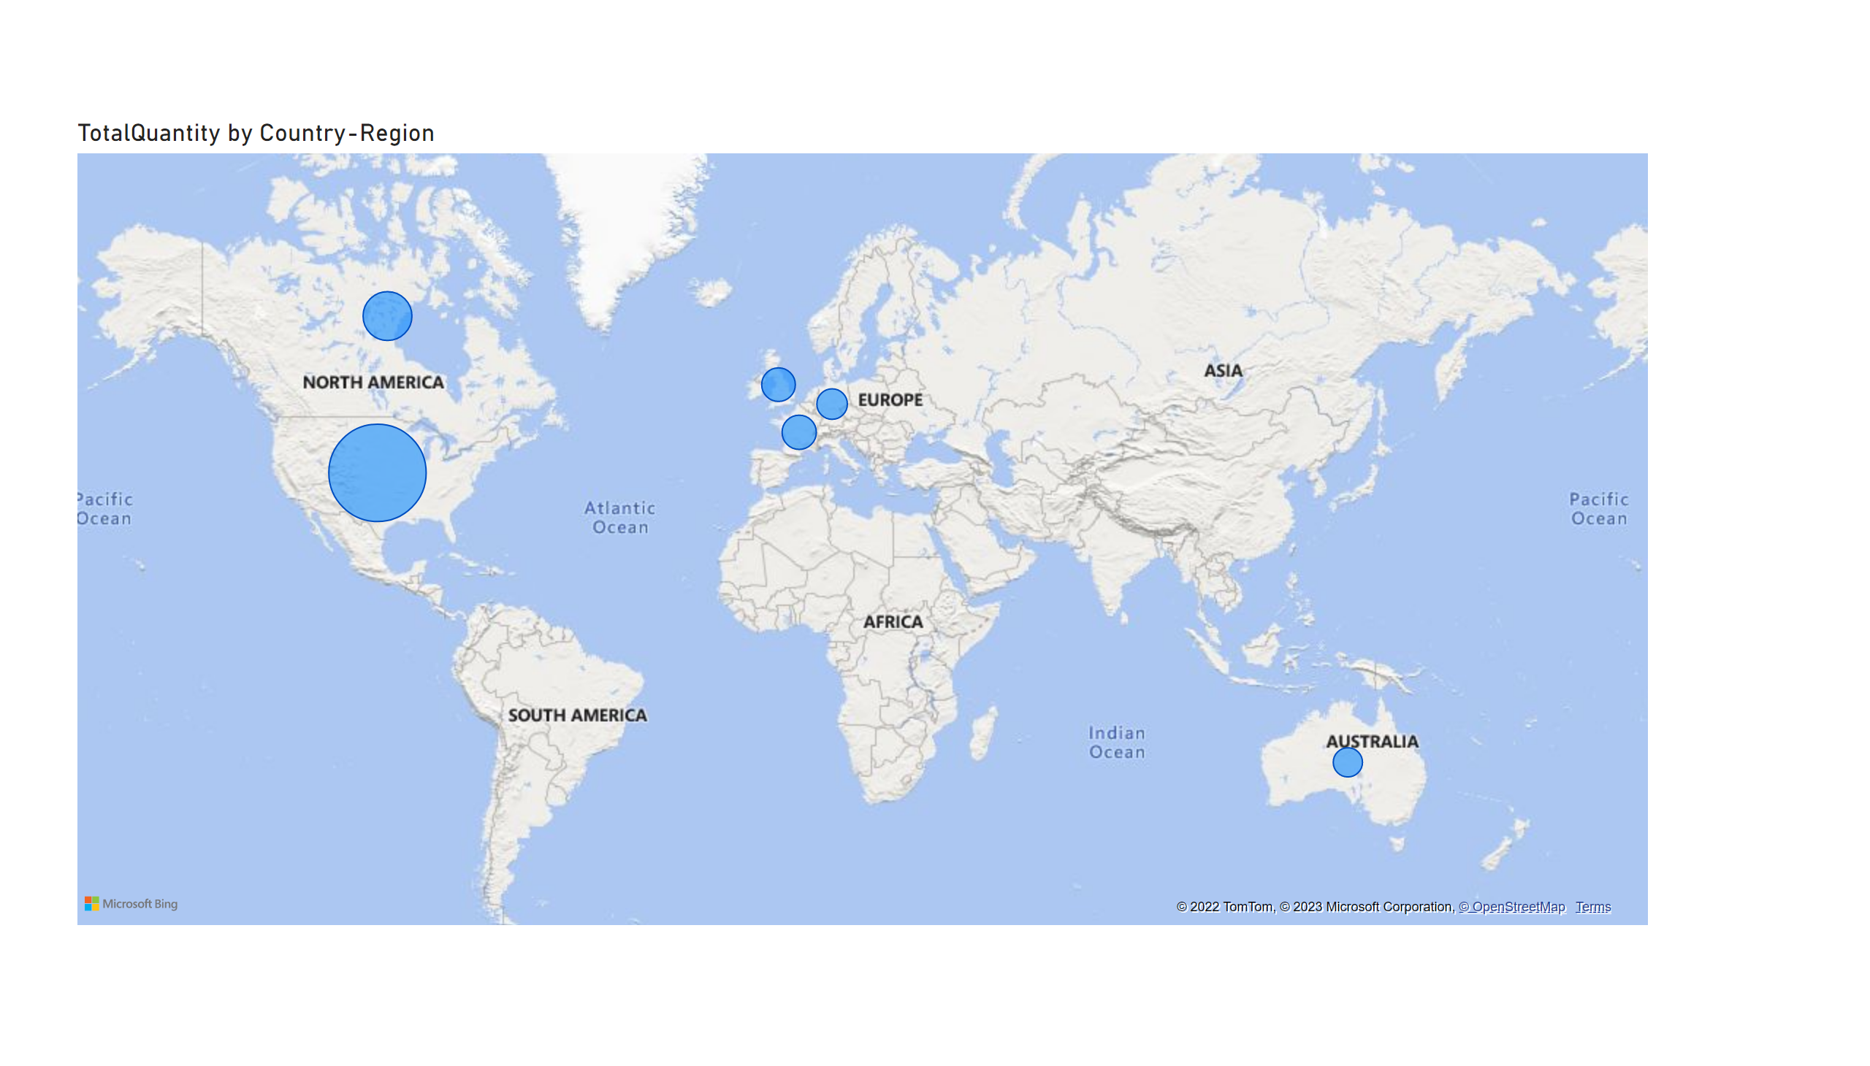
Region
Notes:
map
No alt text provided

Slide 6
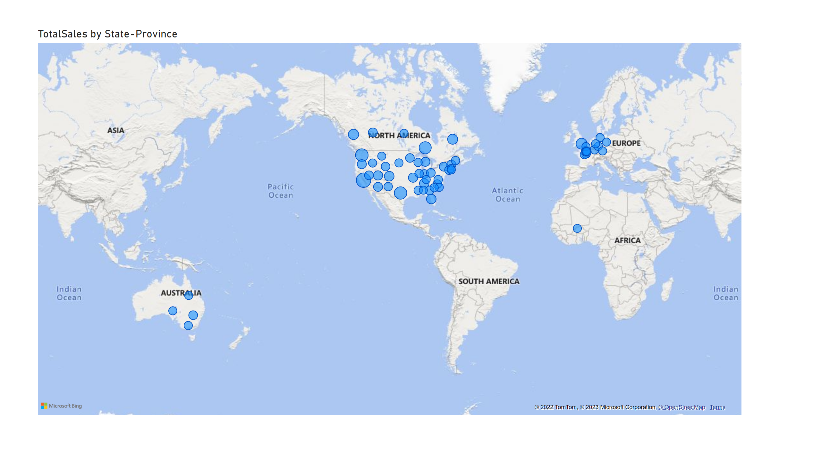
State-Province
Notes:
map
No alt text provided

Slide 7
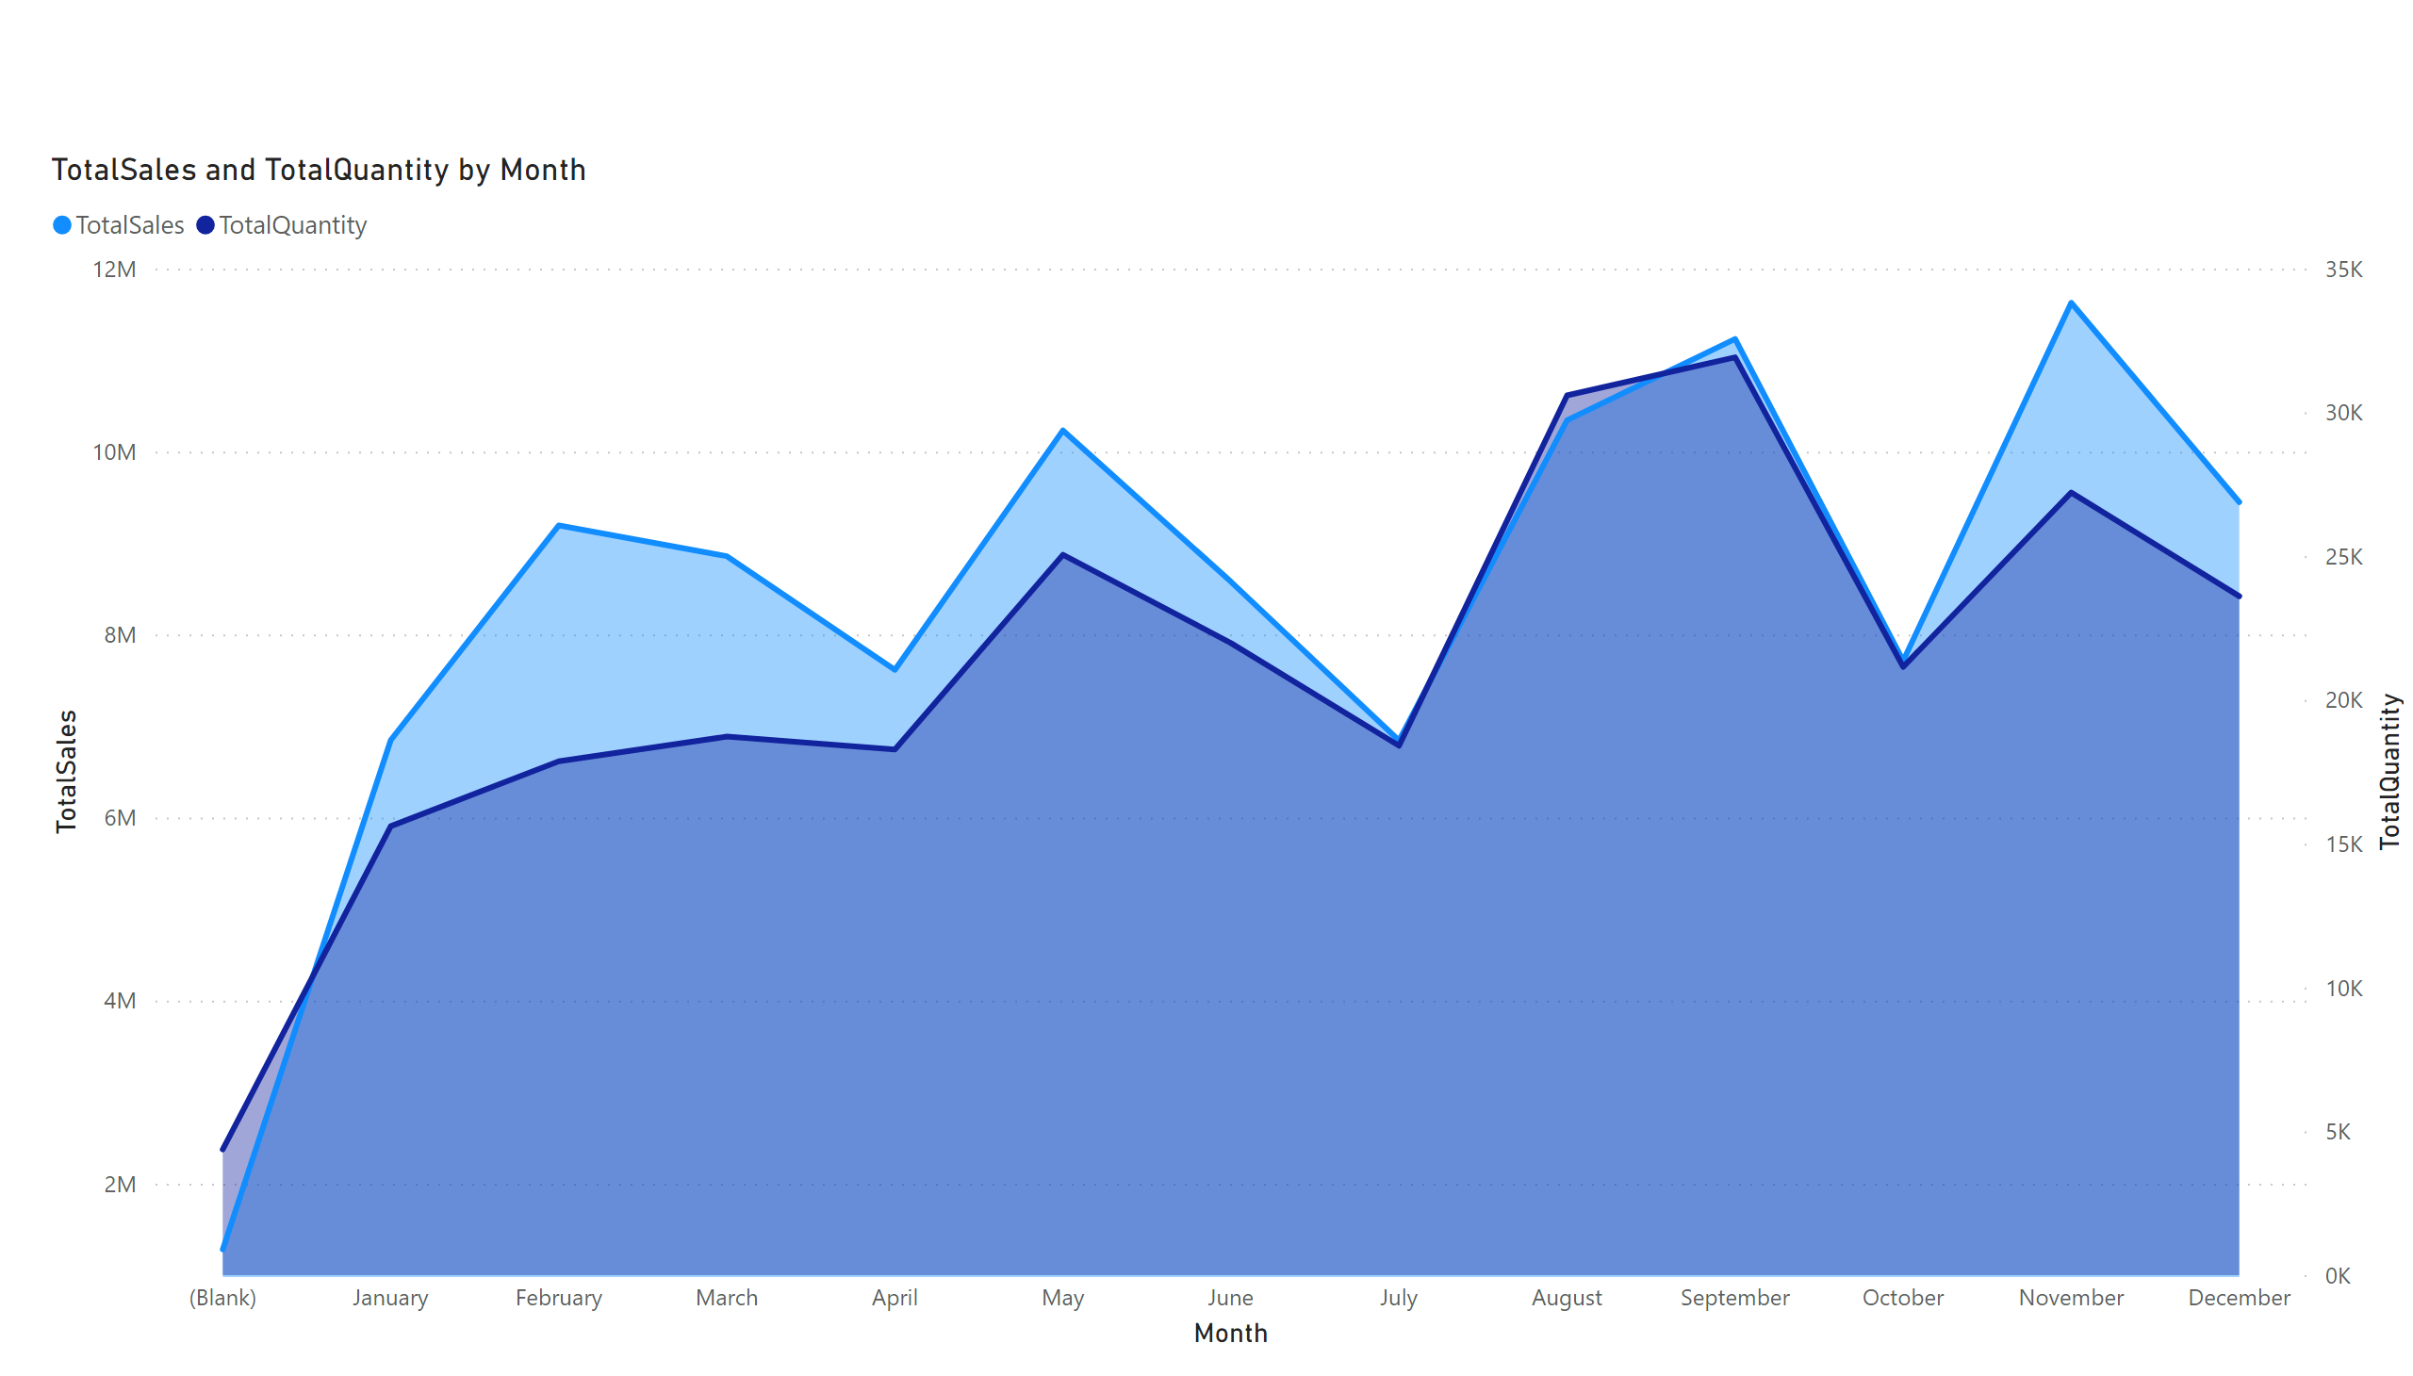
Sales
Notes:
areaChart
No alt text provided

Slide 8
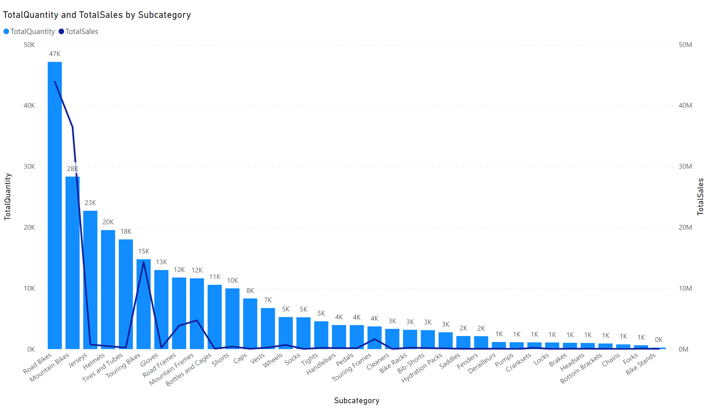
QuantityVsSales
Notes:
lineStackedColumnComboChart
No alt text provided

Slide 9
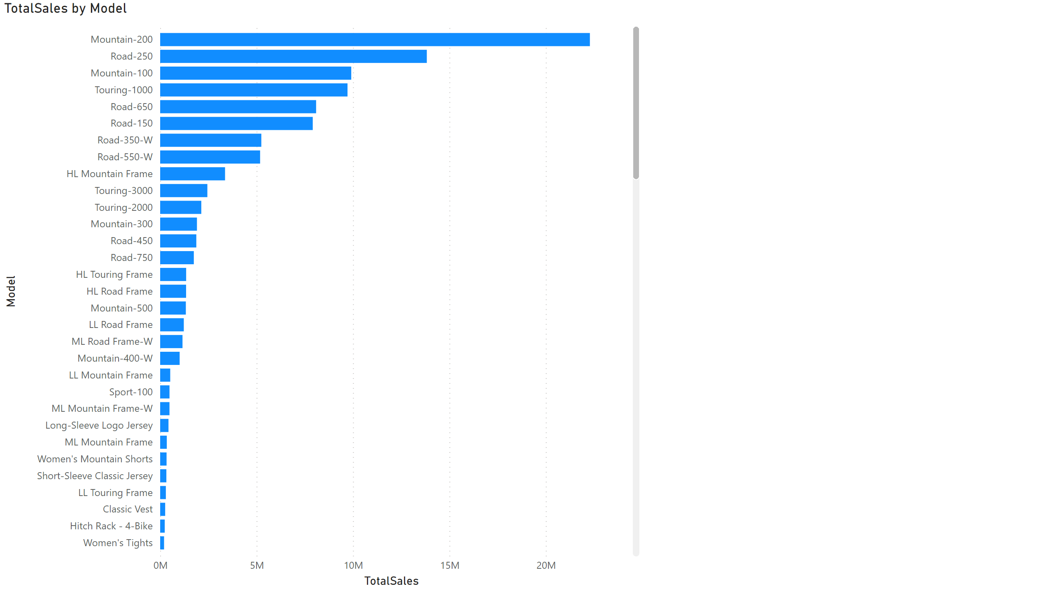
models
Notes:
barChart
No alt text provided

Slide 10
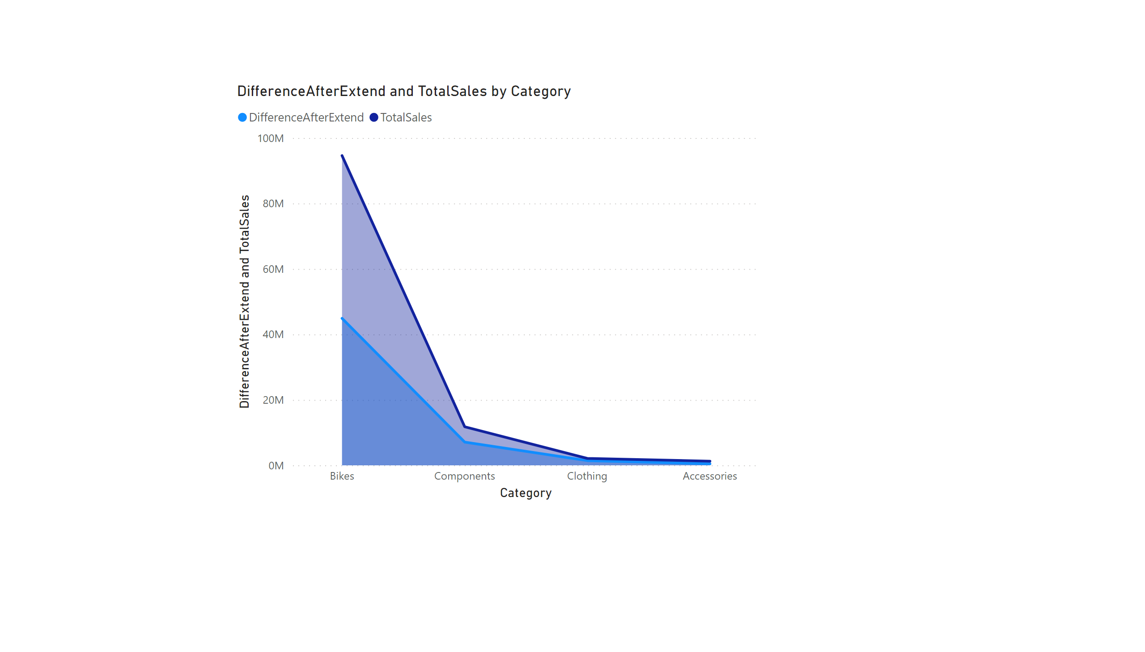
DiffAfterExtend
Notes:
areaChart
No alt text provided

Slide 11
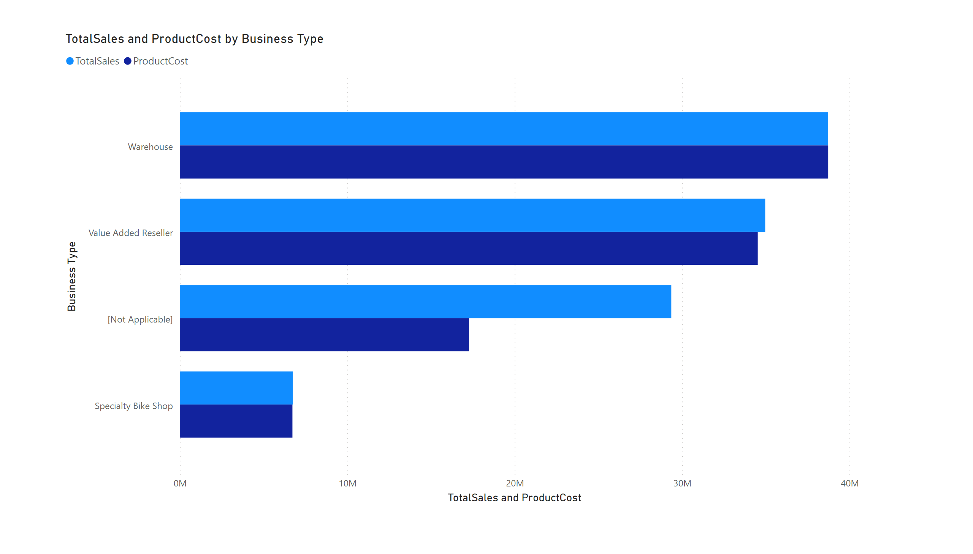
BusinessType
Notes:
clusteredBarChart
No alt text provided

Slide 12
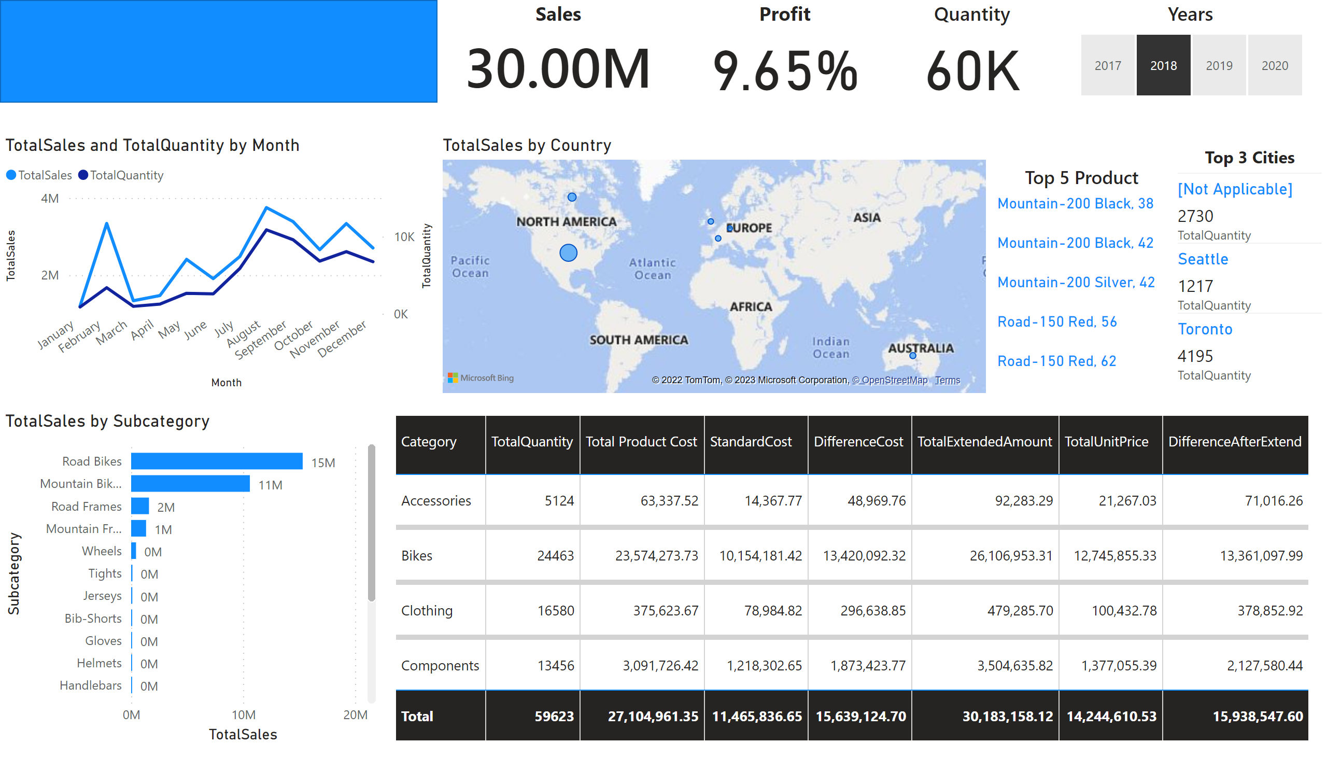
AdvebtureDashboard
Notes:
Quantity
No alt text provided
Sales
No alt text provided
slicer
No alt text provided
Top 5 Product
No alt text provided
Top 3 Cities
No alt text provided
shape
No alt text provided
Profit
No alt text provided
barChart
No alt text provided
lineChart
No alt text provided
map
No alt text provided
tableEx
No alt text provided
Years
No alt text provided

